Slide 1
Group Project 1:
Market Indicators & Political Influences Related to Stock Market Index
Group Members: Aidan, Antony, Lauren, Park

Slide 2

Hypothesis, Assumptions & Objective
Objective:
To explore the accuracy of gold prices as a market indicator in comparison to other possible indicators. Further, we will experiment on combining these indicators with various weight to create a new and better indicator for stock market direction.
Assumptions:
From 1985 to early 2000, gold was used to hedge against market downturn.
When investors were expecting a bear market, they sell shares in stock market and buy gold, causing decline in stock market indices and rise in gold prices.
Therefore, gold price could be used as indicator of stock market direction.
Hypothesis:
The invention of paper gold and founding of commodities futures allowed investors to speculate on several types of commodities including gold. As a result, gold price loses some of it's property to suggest market direction as it is driven by investor's speculation.

Slide 3

Questions for Analysis
Questions for Analysis:
Explore the relationship between S&P 500, Dow Jones, Nasdaq, Gold, Silver, Oil, Crypo, GDP, House Price Index, Interest and Inflation Rates
Find correlations from indices and commodities to compare which has the highest correlation to S&P 500
Combine data into portfolio to try to find a combination that leads to stronger indicator (higher correlation) for S&P 500
Does gold still have any utility in predicting market changes?
Does S&P 500 have correlation to GDP and Interest rate?
Does president have any influence on stock market & GDP?

Slide 4

Data Cleanup & Exploration
Data cleaning was challenging due to mixed labels in different files
Resulted in team re-formatting .csv files for consistency
Different datasets with same data have different formatting, so pulling S&P 500 data from multiple sources leads to consistency issues
Postmortem: create master file for variables or ensure team is only editing to most recent version of master file
Interestingly, noticed that libraries and dependencies ordering is important, otherwise may result in an error message:
E.g. “WARNING:param.panel_extension: A HoloViz extension was loaded previously. This means the extension is already initialized and the following Panel extensions could not be properly loaded: ['plotly']. If you are loading custom extensions with pn.extension(...) ensure that this is called before any other HoloViz extension such as hvPlot or HoloViews.”
Multi-indexing is helpful to demonstrate changes when there is a significant different in variable values

Slide 5
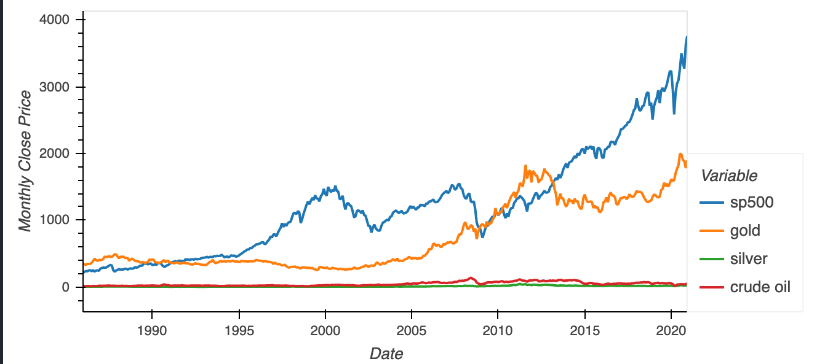
Data Analysis:
Indices
The correlation started to change to positive due to creation of paper gold and commodities market in 1970's.
However, it took some time for the paper gold and commodities futures market to be popularized and accessible to retail investors; therefore, the transition was not apparent until mid 2000's.
Commodities market allows traders and investors to speculate on future commodities prices.
As a result, the gold price correlation began to shift to positive territory
Since 2007, Crude Oil > Gold correlation to S&P 500
Cryptocurrencies have weak correlation to S&P 500

Slide 6
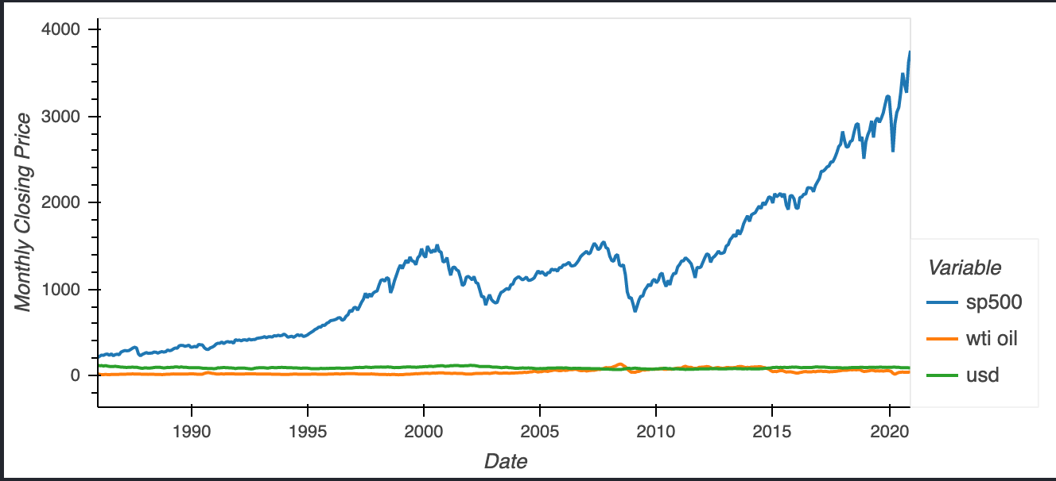
Data Analysis:
Commodities
US Dollar index has very little correlation with the S&P 500 index throughout time
likely a result of the money market being used as a very liquid, non-risky area of investment especially being in the form of a strong world currency such as the USD
The West Texas Intermediate (WTI) is more correlated to the S&P 500 index and the WTI stock has become more so in the more recent years
likely due to investor speculation on these kinds of commodities in more recent years as the future of the oil industry is unknown, combined with various political influences affecting supply

Slide 7

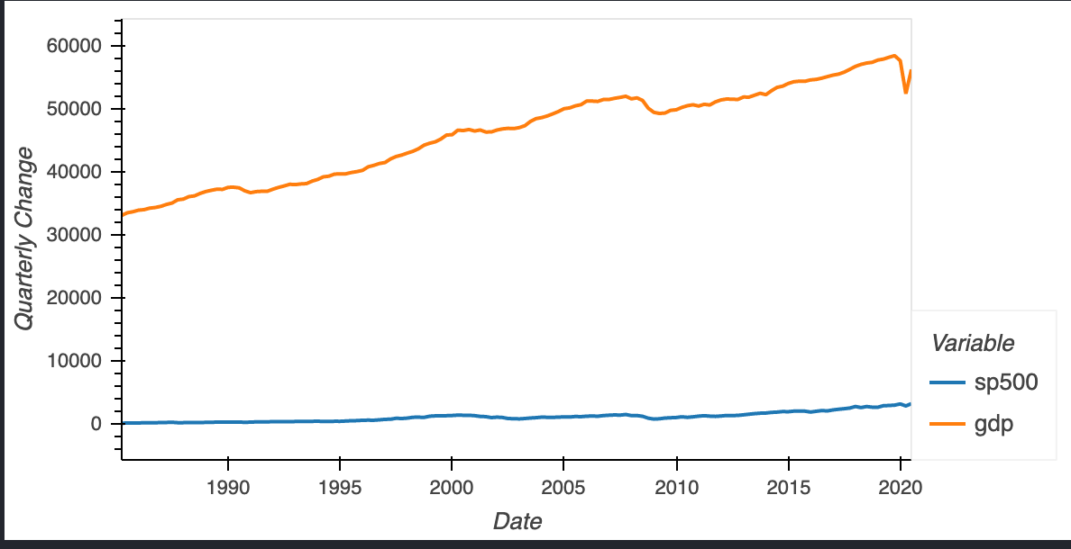
Data Analysis:
Economic indicators
Does S&P 500 have correlation to GDP and Interest rate?
Interest rate and S&P 500 index has a very little to no correlation between them
GDP seems similar to S&P 500, line trends positively for both and heat map shows some correlation between them as well

Slide 8
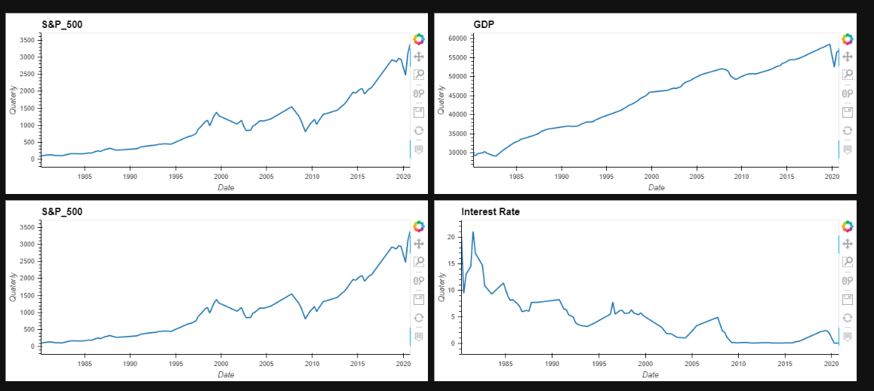
Data Analysis:
Economic indicators (cont’d)
Does Presidency have any influence on stock market & GDP?
Little impact on growth and changes in stock market
Observe the S&P 500 growing positively through all year regardless of the president
GDP trends positively regardless of president.
fluctuation in the market are mostly likely due to external factors (COVID, 9/11, Recession of 2008) likely unrelated to presidential policies.
According to indicators analysed in this research shows that president has little to no influence on the stock market

Slide 9

Data Analysis
Highest correlation to stock market index: Crude Oil (0.14)
Second highest correlation: Silver (0.1)
Tested various combinations and determined that an equal weight between crude oil and silver will provide highest correlation (0.16)
When silver & crude oil portfolio returns are graphed, we can see the trend moves in the same direction as S&P500 in the last 5 years.
likely due to up to 2015, US and Saudi Arabia have been manipulating oil prices in oil price war.
also, gold and silver have been used as hedging commodities
Oil and silver have slightly higher correlation to S&P 500 in the past 5 years
When looking at beta graphs, I noticed that crude oil and silver have lower beta than other commodities indicating lower volatility to S&P 500

Slide 10
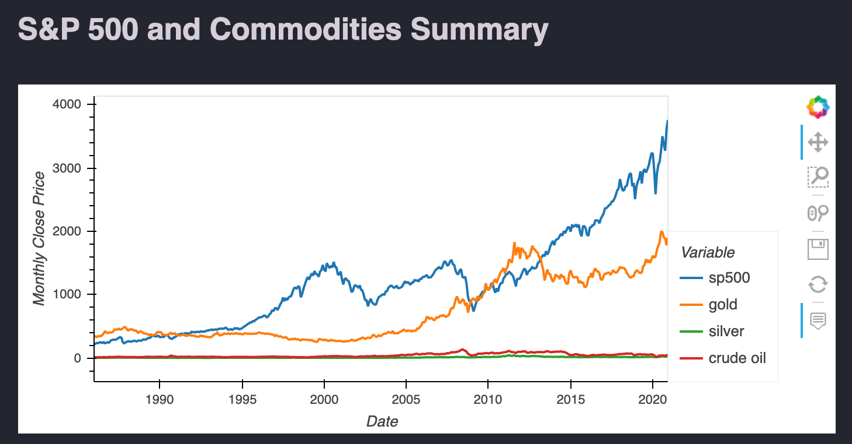
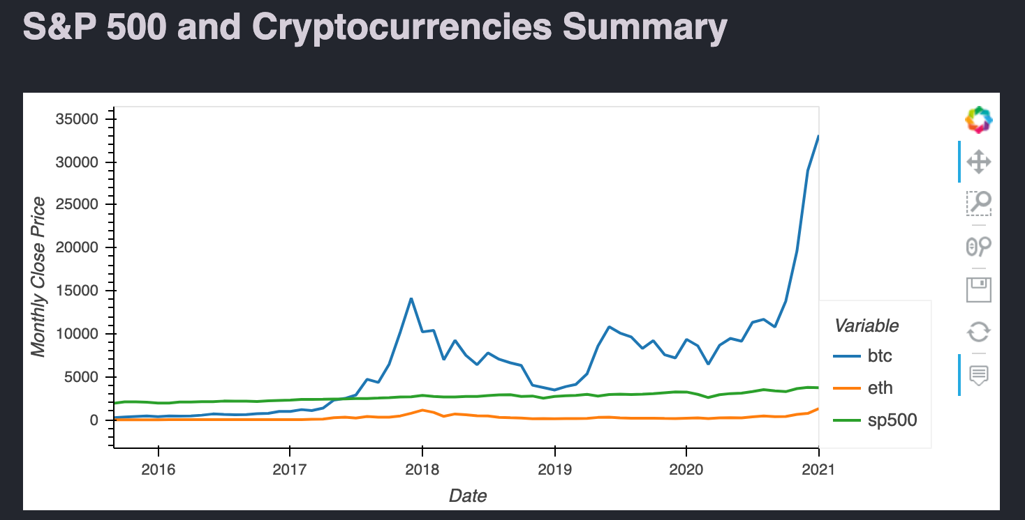
Summary
Crude Oil has become more correlated to S&P 500
than gold.
Cryptocurrencies have weak correlation to S&P 500.

Slide 11
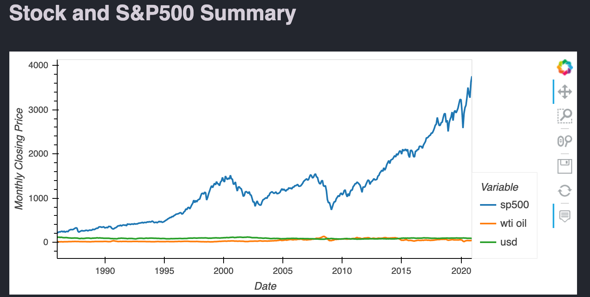
Summary cont’d
USD has very little correlation to the S&P 500

Slide 12
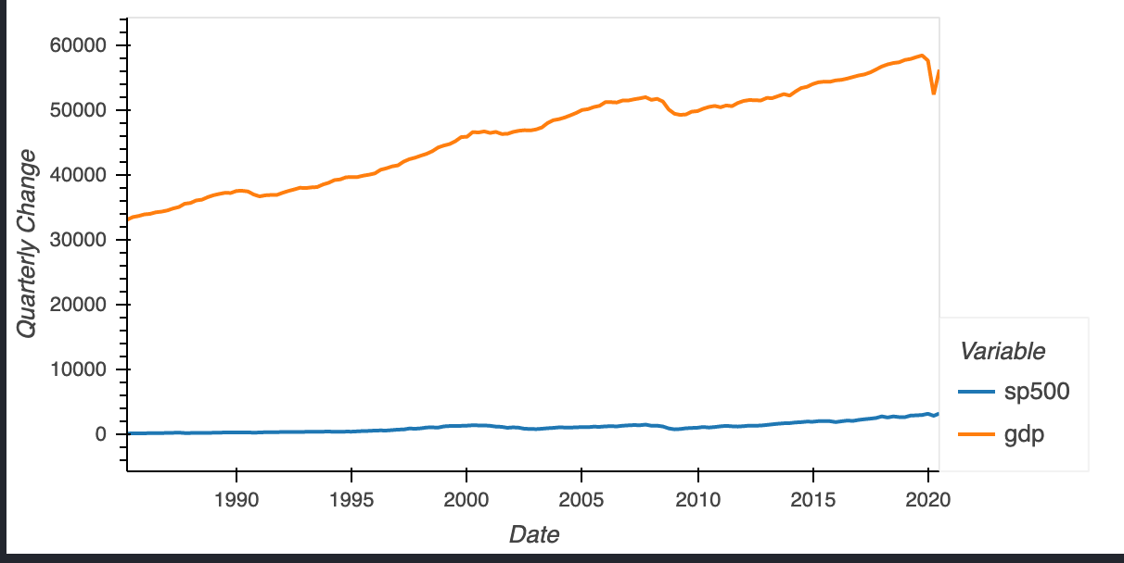
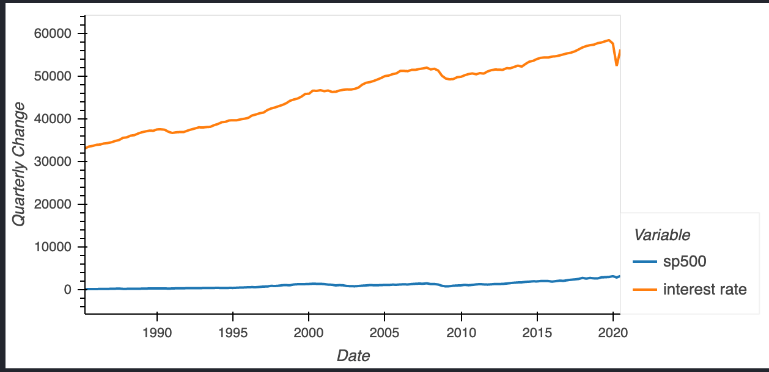
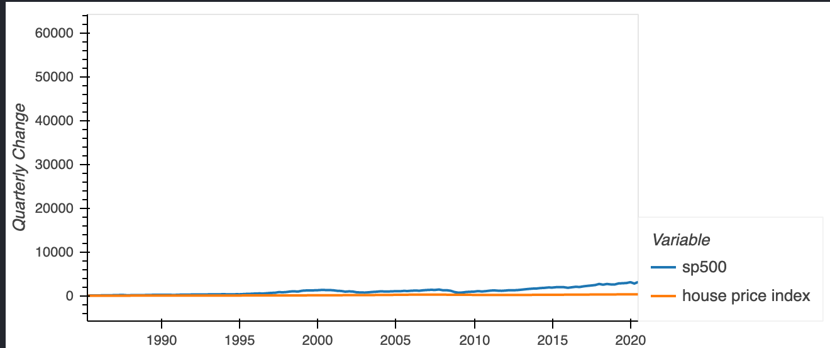
Summary cont’d
No correlation with presidency and market indicators.
No correlation with housing price index or inflation rate

Slide 13
Discussion
Open for questions

